Slide 1
Optical Character Recognition
Based on Python
By Jiecheng Song & Ruijun Wu

Slide 2
The Background and Purpose

Slide 3
Brief motivation
There are three aspects of why we come up with this idea:
First, the OCR is widely used and applied in our lives and we can use this technique to make life and work more efficiently.
Second, after looking some paper we realize that the main ideas of these algorithms used in OCR are not very profound. Most of them are quite reasonable and achievable to us somehow even if we may still face some difficulties in practice which will be explained later).
Third, this is a really practical and meaningful topic.

Slide 4
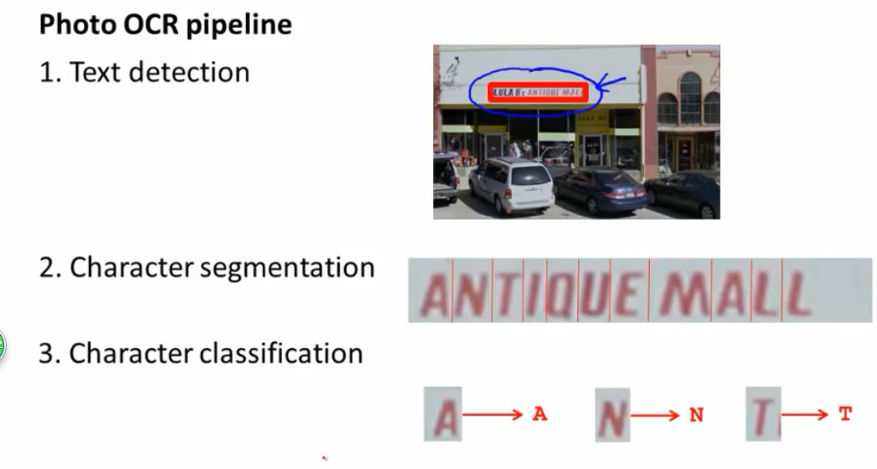
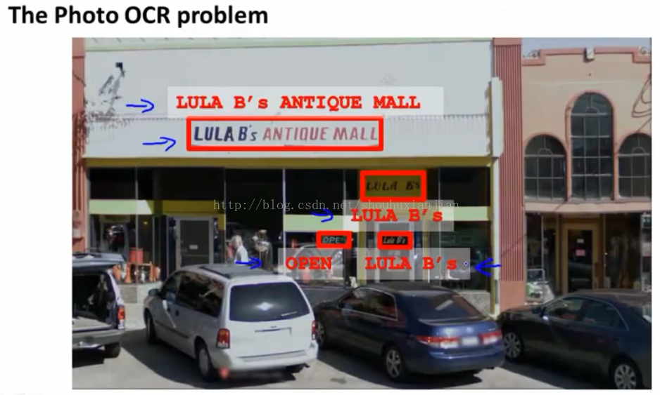
An Example of Application

Slide 5
Brief introduction of methods we used
The main idea of the project is based on grayscale which can represent every point’s value of RGB. Typically, 255 is taken to be white and 0 is taken to be black. In other words, we can recognize the color of a point from a specific number(value of grayscale). So we can input a photo and convert it to a matrix which are formed by every point’s grayscale. Basically, our algorithm is based on the operation of matrix.
Next, we want to cut background off and decide where are the boundaries of words to extract words
Finally, we identify 52 english characters and main punctuations, where we use the most important algorithm: Support Vector Machine(SVM) to split every word.

Slide 6
The main problem we face
The most difficult issue we meet is how to extract word from a complicated background, because the boundary between background and words is hard to distinguish. The main reason is that colorful background has various gray scales, so where the words are is hard to identify.
So, after discussion, we decided to simplify the condition and choose the simplest case: white backgrounds and colourful characters. It is something that is not far more than our ability.

Slide 7
The main challenges in our project
How to cut the background off;
How to extract every word out;
How to classify the different characters and tell the machine to recognize them ;
How to solve the ambiguities of blanks and some characters: I and l, i and ,, w and W, v and V, o and O, x and X and so on.
Fortunately, we have almost figure out how to solve these problems.

Slide 8
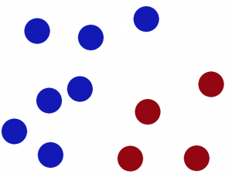
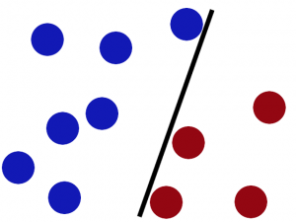
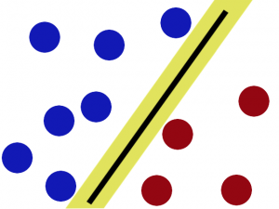
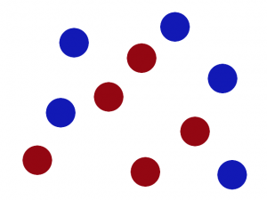
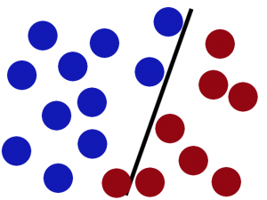
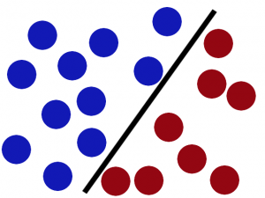
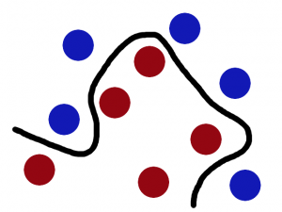
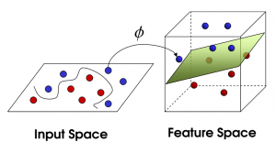
Support Vector Machine (used as classification)

Slide 9
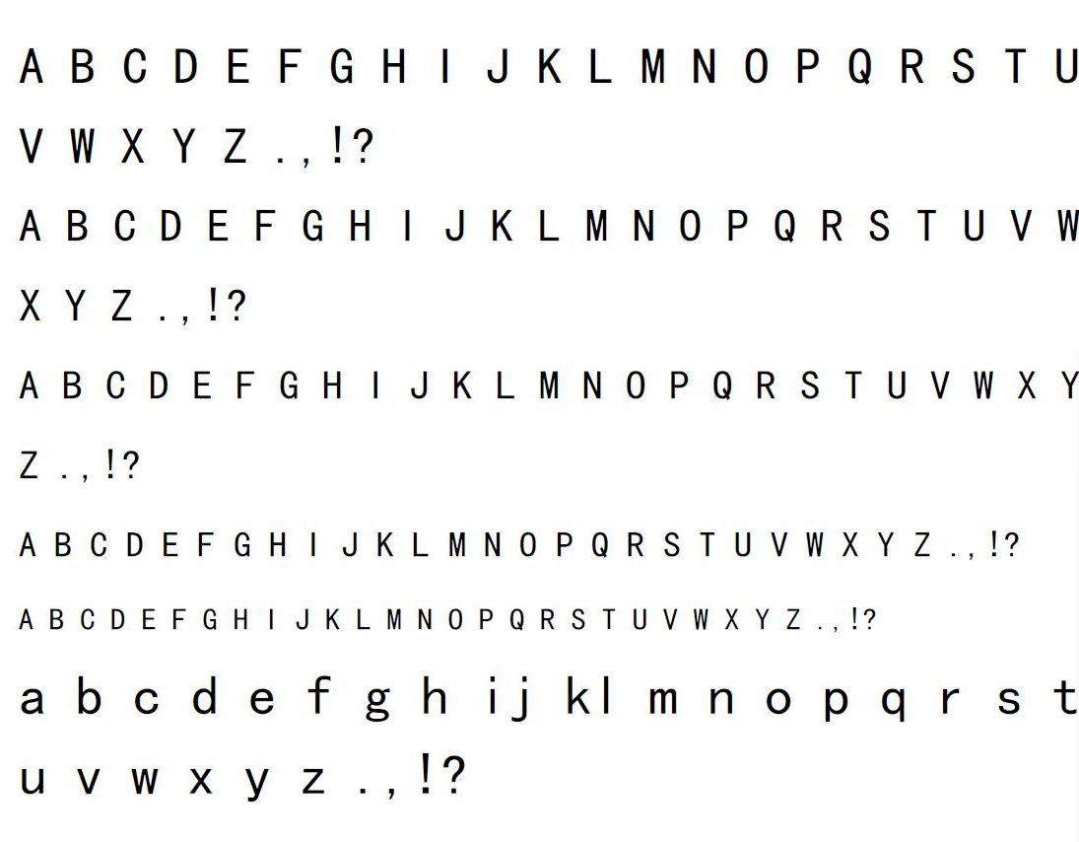
And our train set
With this train set, we can use them to train the SVM Algorithms to get coefficients of the model.

Slide 10
90%
The accuracy rate so far.

Slide 11
The performance of our code

Slide 12
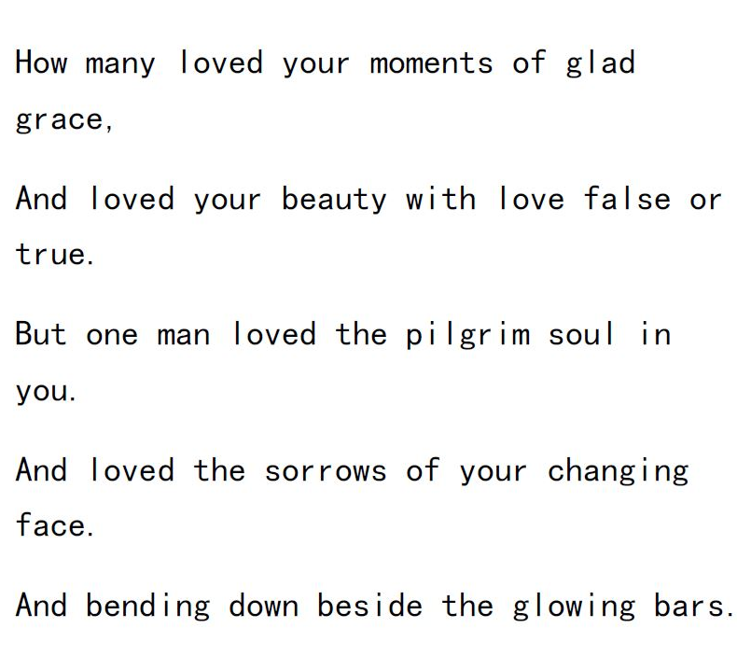
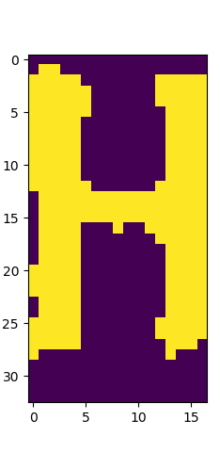
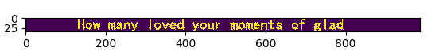
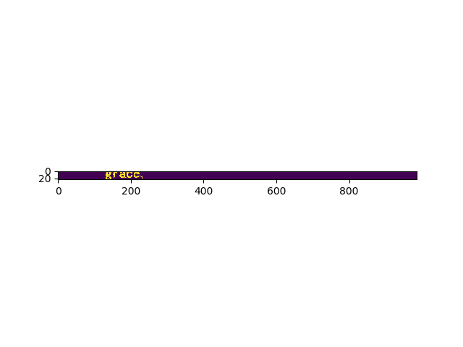
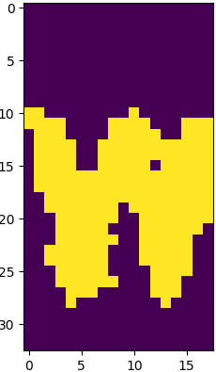
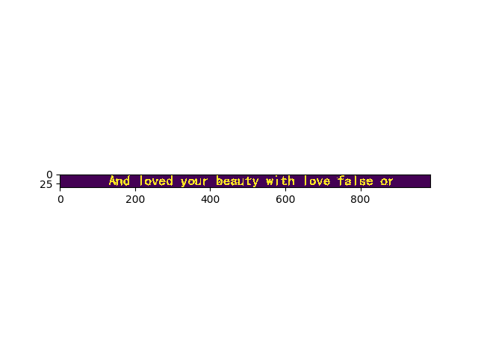
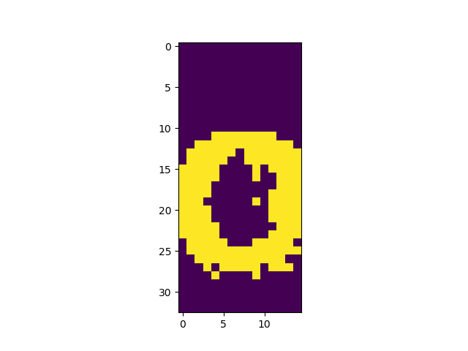
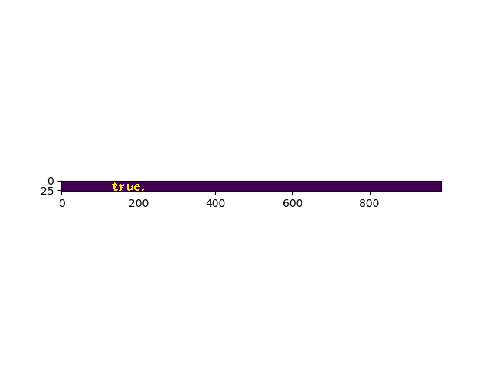
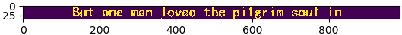
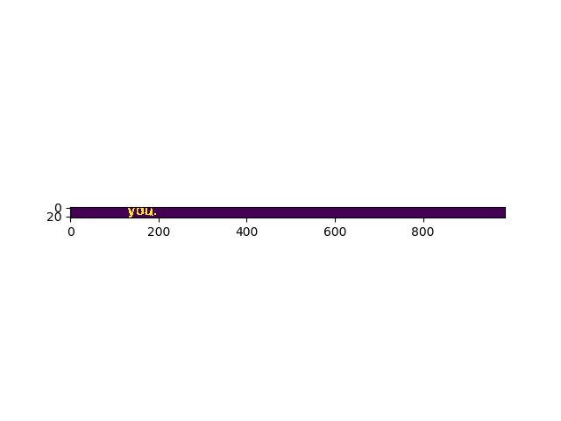
As we put this image in

Slide 13
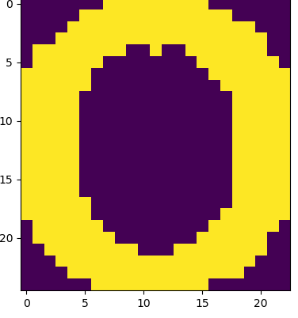
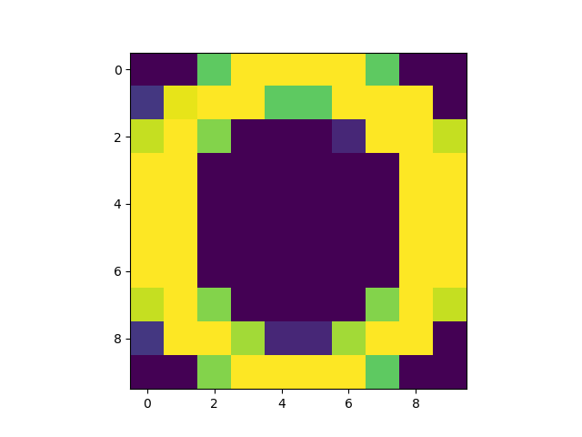
And then we need to cut the background in a specific character’s matrix again. Then we want to zoom them in or out to the same size of matrix.
The matrix after columns cutting
The matrix after rows cutting
The matrix after scaling

Slide 14
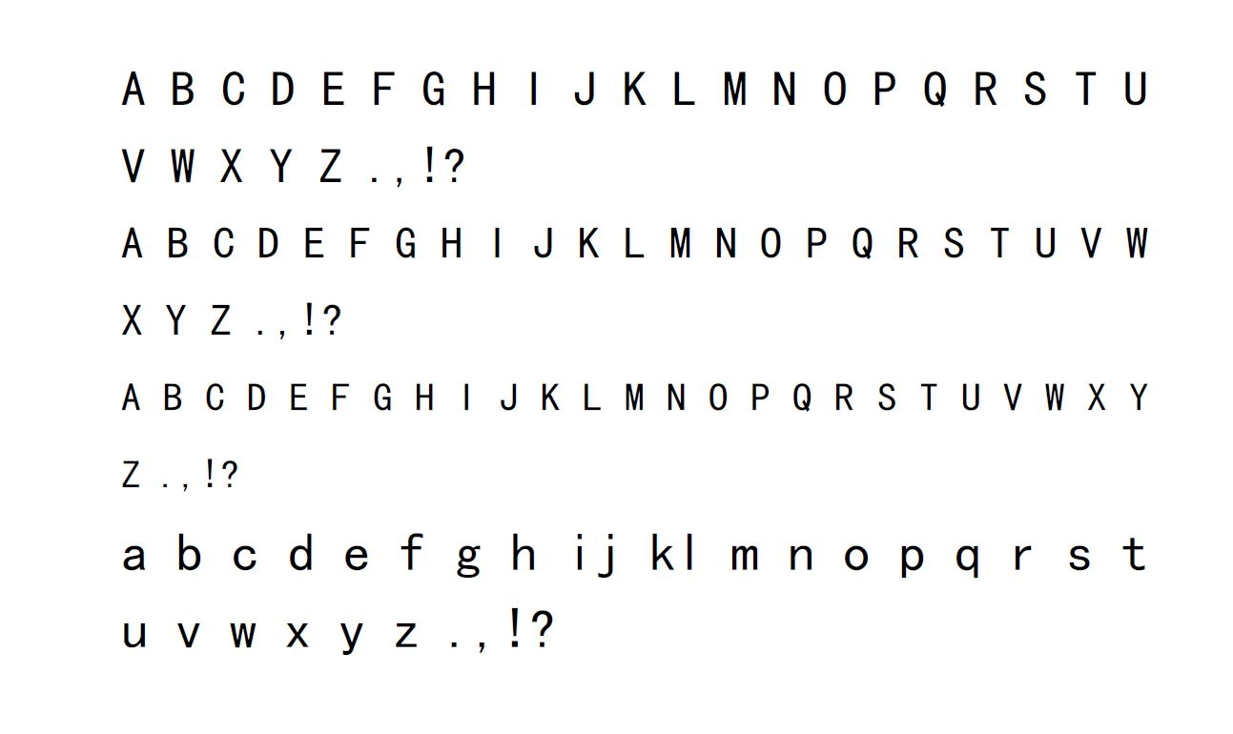
Training set for SVM to classify
Their corresponding signs：
1，2，3，4，5，6，7，8，9，10，11，12，......
47,48,49,50,51,52,53,54,55,56

Slide 15
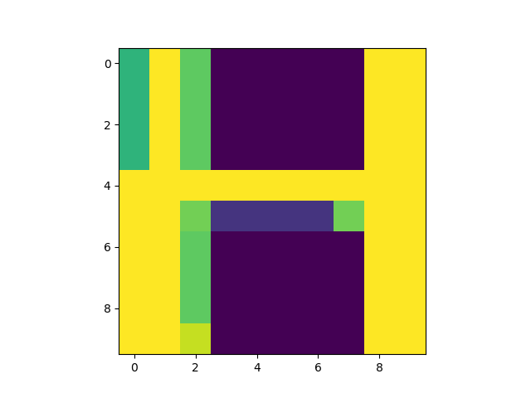
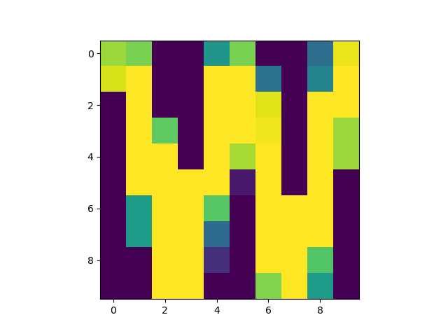
Classify
8
41
42

Slide 16
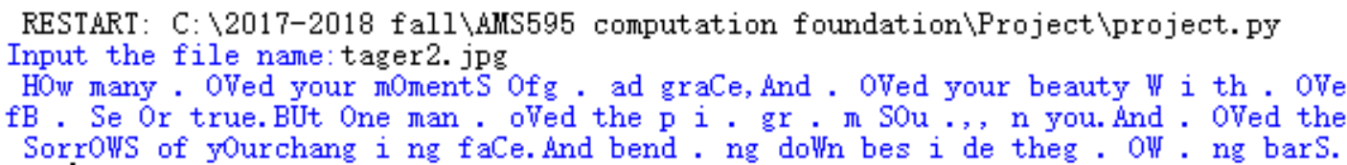
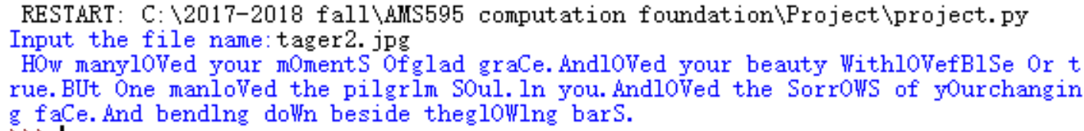
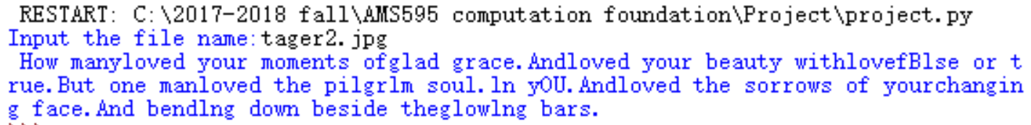
Improvement

Slide 17
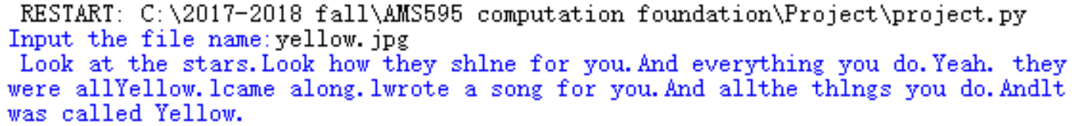
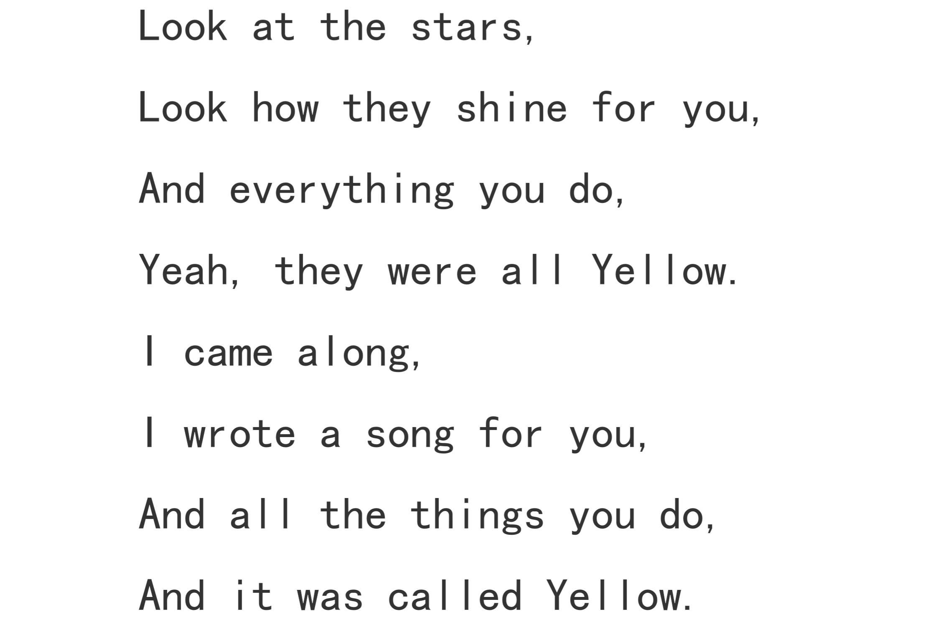
Another example to test our program

Slide 18
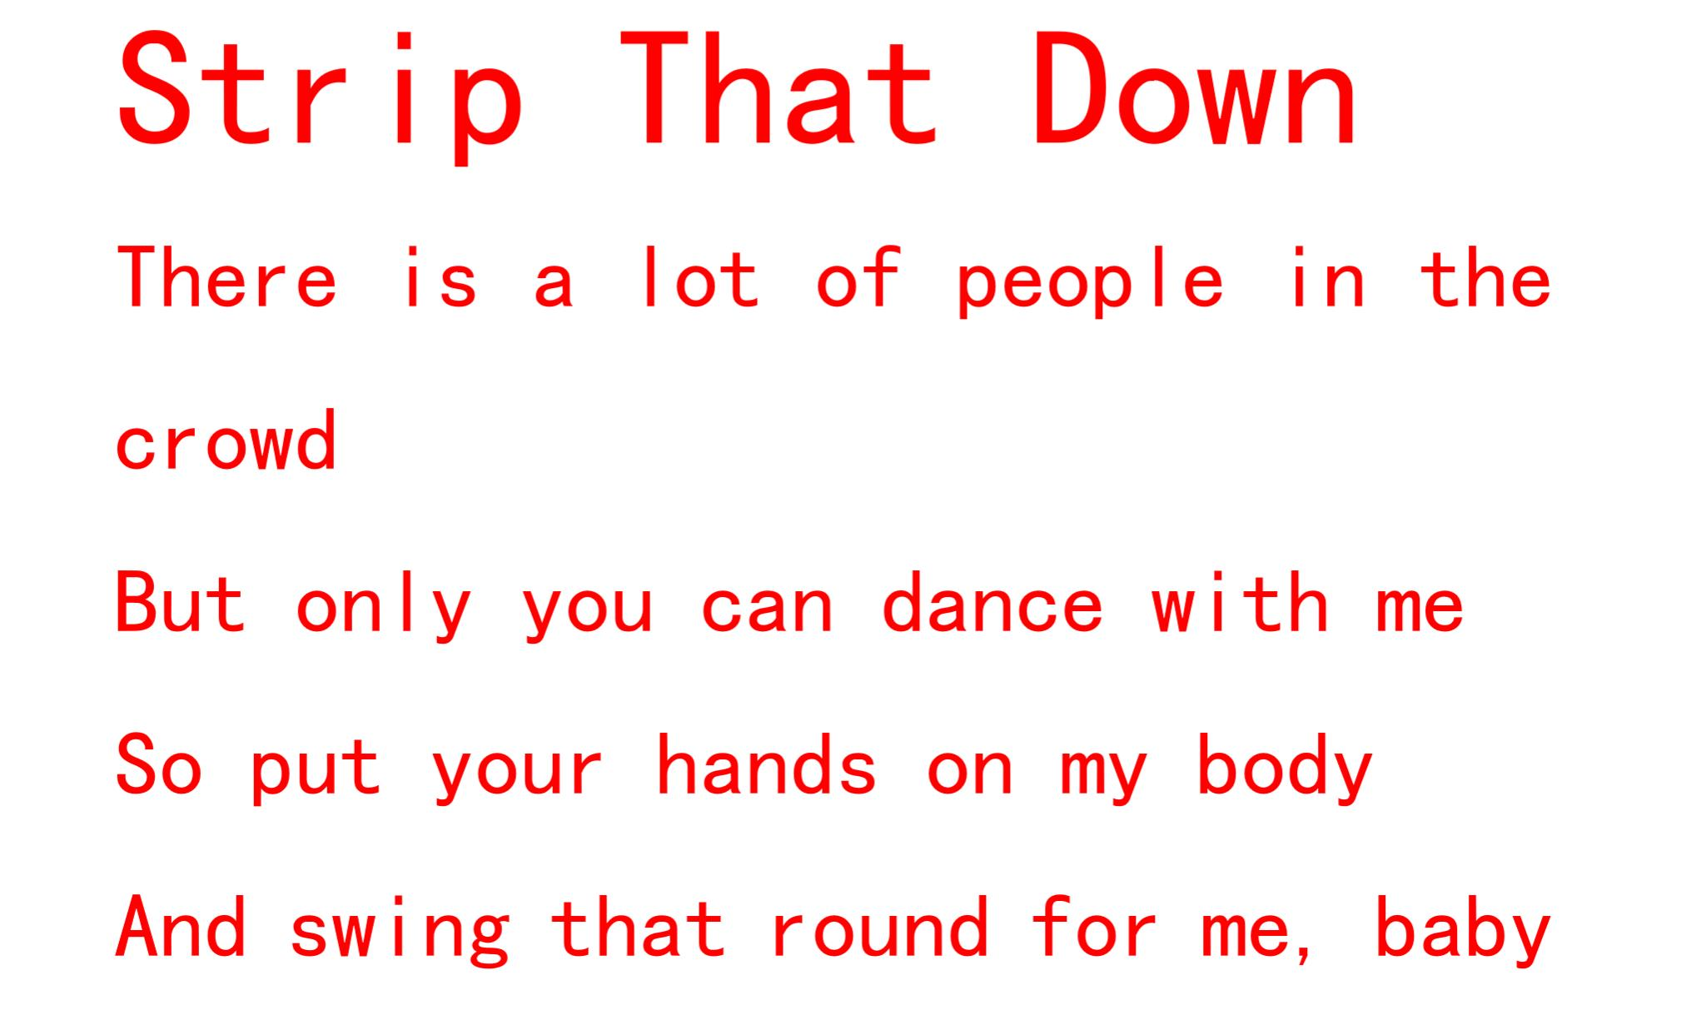
The colorful characters and different sizes

Slide 19
Expectation for the future
to recognize MORE fonts in English
to identify the every blank
Higher accuracy rate : 97%

Slide 20
THANK YOU !

Slide 21
APPENDIX :
A part of our codes

Slide 22
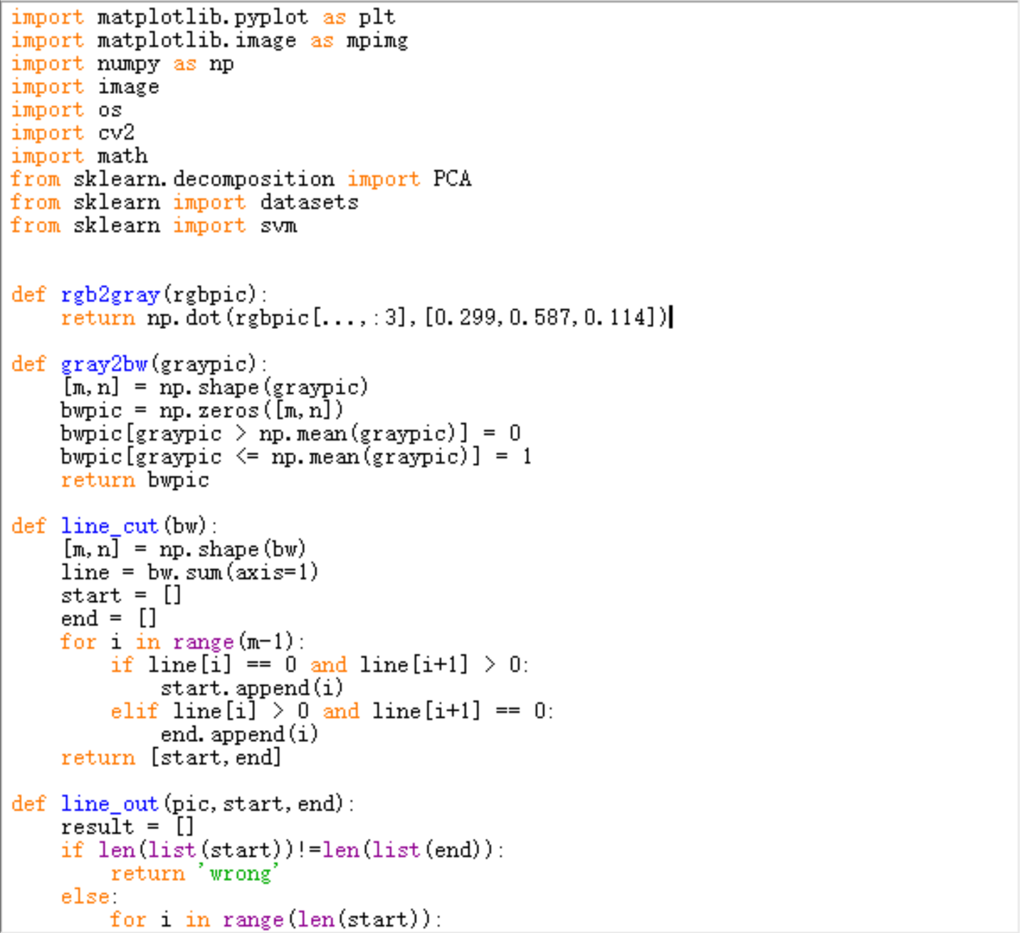
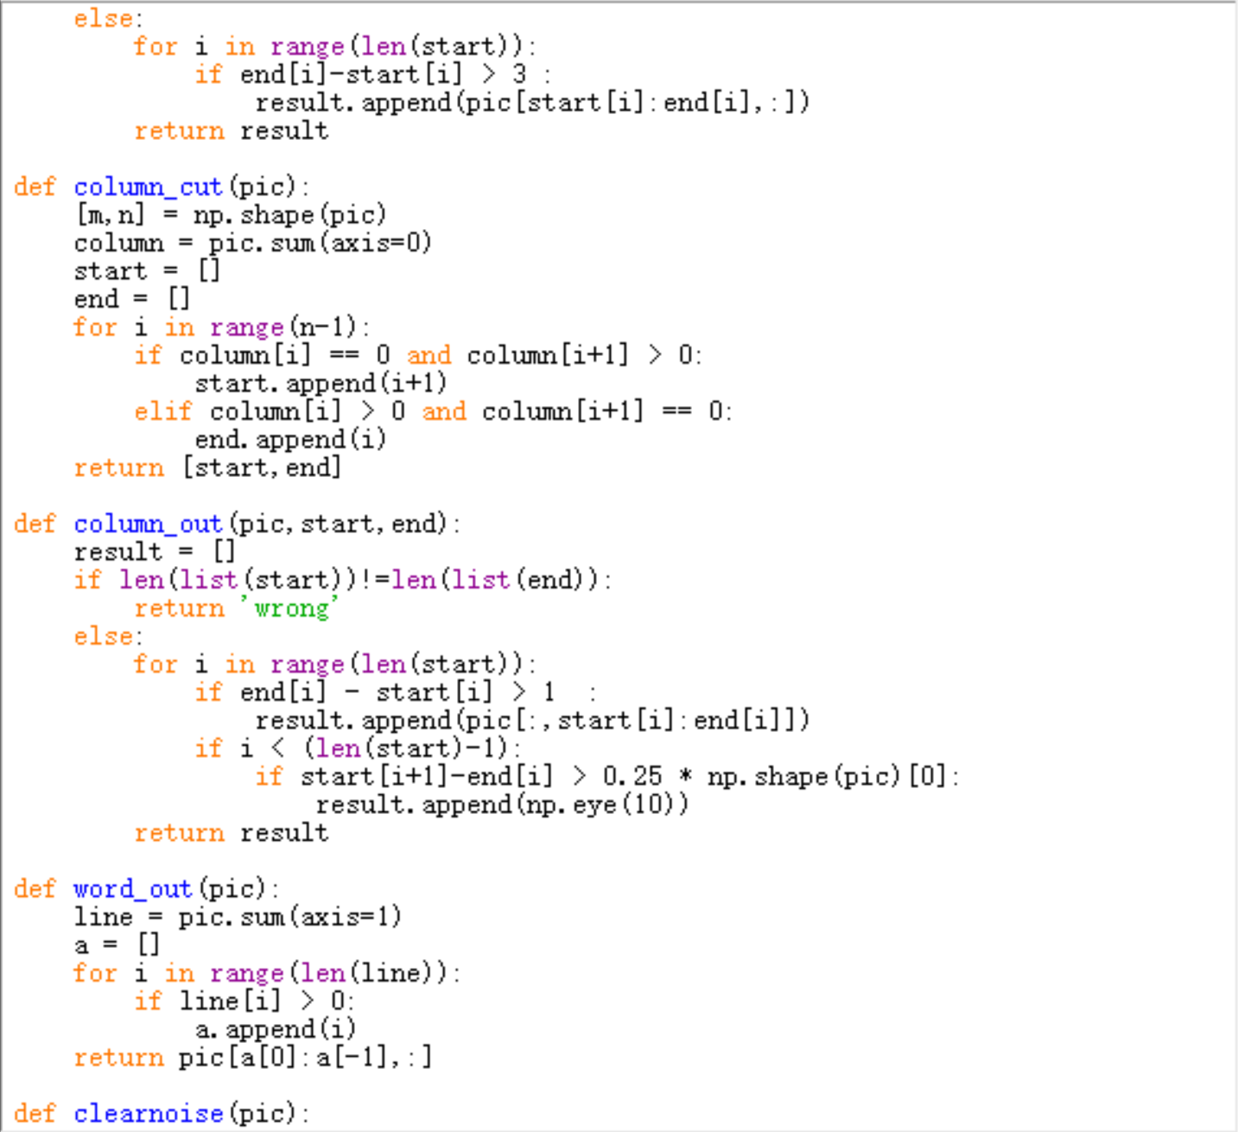

Slide 23
